Slide 1
Next Hikes IT Solutions
Project 3:
Exploratory Data Analysis (EDA) for Real Estate Pricing: Unveiling the
Dynamics of House Valuation in a Dynamic Market
Name:- Shubham Gupta

Slide 2
Using library pandas, matplotlib.pyplot, NumPy and seaborn impoart data in python and visualize.
Using info():The.info() method provides a concise summary of the DataFrame, including:
. info(): Gives you a quick overview of the DataFrame’s structure and data types.The number of entries (rows)
The number of columns
The names of the columns
The data types of each column
Memory usage

Slide 3
3. Using .head() The .head() method returns the first five rows of the DataFrame,which is useful for quickly inspecting the data.
.head(): Allows you to preview the first few records, helping you understand the content and format of your data.
4.Using .tail() The .tail() method returns the last five rows of the DataFrame, Bywhich is useful for quickly inspecting the data.
.tail(): Allows you to preview the last few record, helping you understand the specify the number of rows you want by passing an integer as an argument.
5. Using .shape The .shape() attribute in pandas is used to get the dimensions of the DataFrame. It returns a tuple that represents the number of rows and columns in the dataframe.
6. Using isnull().sum().iloc[] method is commonly used in pandas to check for missing values in a DataFrame.

Slide 4
7. Using duplicated().sum() method in pandas is used to identify and count the number of duplicate rows in a DataFrame.
8. Using fillna(method=‘mode and median') method in pandas is used to fill missing values (NaN) in a DataFrame by backfilling. This means that for any missing value, the next valid value from the DataFrame will be used to fill it.
9. Using .drop() unnecessary columns or duplicates from a DataFrame in pandas, you can use a combination of the drop() and duplicated() methods.
Use drop(): You can specify the columns you want to remove.
Use drop_duplicates(): This method removes duplicate rows from the DataFrame.
· Dropping Columns: Use drop(columns=[...]) to remove any columns that are not needed.
· Removing Duplicates: Use drop_duplicates() to ensure each row in the DataFrame is unique.

Slide 5
10. Using .describe() method returns description of the data in the dataframe. If the dataframe contains numerical data, the description contains these information for each column:
. Count: The number of not-empty values.
. Mean: The average (mean) values.
. std: The standard deviation.
. min: The minimum values.
. 25%: The 25% percentile.
. 50%: The 50% percentile.
. 75%: The 75% percentile.
. max: The maximum values.
Data Visualize using key : boxplots, subplot, histplot, lineplot, scatterplot, pairplot, heatmap, barplot and scatterplot for data figure.

Slide 6
Creating visualizations like boxplots and subplots, can help you understand your data better.
Boxplots
A boxplot (or whisker plot) displays the distribution of data based on a five-number summary: minimum, first quartile (Q1), median, third quartile (Q3), and maximum. It’s useful for identifying outliers.
Subplots
Subplots allow you to display multiple plots in one figure. You can specify the number of rows and columns for the layout.
Summary
Boxplots are great for comparing distributions and spotting outliers.
Subplots allow for multiple visualizations in one figure.

Slide 7
The Seaborn.histplot() method helps to visualize dataset distributions. We can draw either univariate or bivariate histograms. A histogram is a traditional visualization tool that counts the number of data that fall into discrete bins to illustrate the distribution of one or more variables. This function can add a smooth curve derived using a kernel density estimate to the statistic computed within each bin to estimate frequency, density, or probability mass.
Line charts are used to represent the relation between two data X and Y on a different axis.
A scatter plot is a diagram where each value in the data set is represented by a dot.
A pair plot, also known as a scatterplot matrix, is a matrix of graphs that enables the visualization of the relationship between each pair of variables in a dataset.
Heatmap is defined as a graphical representation of data using colors to visualize the value of the matrix

Slide 8
. A bar plot is a plot that presents categorical data with rectangular bars with lengths proportional to the values that they represent.
. Using forloop for heandling outliers and upper and lower limit for numerical column.
Univariate analysis involves examining the distribution and characteristics of a single variable. It can help in understanding the underlying patterns, tendencies, and behavior of that variable. Here are some common techniques and visualizations used in univariate analysis:
Descriptive Statistics
Mean: The average value of the data points.
Median: The middle value when the data points are ordered.
Mode: The most frequently occurring value.
Variance: The spread of the data points around the mean.
Standard Deviation: The square root of the variance, indicating the dispersion of the data points.

Slide 9
Multivariate analysis involves examining the relationships and interactions between multiple variables in a dataset. It's essential when trying to understand the complex dynamics within your data. Here are some common techniques and visualizations used in multivariate analysis:
Techniques
Correlation Matrix: Shows the correlation coefficients between pairs of variables.
Principal Component Analysis (PCA): Reduces the dimensionality of the data while preserving most of the variance.
Multiple Regression: Models the relationship between a dependent variable and multiple independent variables.
Cluster Analysis: Groups similar observations into clusters.
Factor Analysis: Identifies underlying factors that explain the pattern of correlations within a set of observed variables.

Slide 10
Feature engineering is a crucial step in the data preprocessing pipeline, where you create new features or transform existing ones to improve the performance of machine learning models. Here are some common techniques and examples of feature engineering:
Common Techniques:
Missing Value Imputation: Fill in missing values using techniques like mean, median, or mode imputation, or more advanced methods like KNN imputation.
Encoding Categorical Variables: Transform categorical variables into numerical values using methods like one-hot encoding, label encoding, or target encoding.
Binning: Group continuous variables into discrete bins or intervals.
Scaling and Normalization: Adjust the scale of numerical features to have similar ranges using techniques like min-max scaling, standardization, or normalization.

Slide 11
5. Scaling and Normalization: Adjust the scale of numerical features to have similar ranges using techniques like min-max scaling, standardization, or normalization.
6. Polynomial Features: Generate polynomial and interaction terms from existing features to capture non-linear relationships.
7. Text Vectorization: Transform text data into numerical representations using techniques like TF-IDF, word embeddings, or bag-of-words.
Understanding market trends and historical pricing is crucial for making informed investment decisions. Here's a brief overview:
Market Trends
Market trends refer to the general direction in which a market or the price of an asset is moving over a period of time. These trends can be short-term, medium-term, or long-term and can be influenced by various factors such as economic indicators, political events, and investor sentiment. Some common market trends include:
Bull Market: A market in which prices are rising or are expected to rise.

Slide 12
Bear Market: A market in which prices are falling or are expected to fall.
Sideways Market: A market in which prices are moving within a relatively narrow range without a clear upward or downward trend
Historical Pricing
Historical pricing involves analyzing past prices of stocks, indices, or other financial instruments to identify patterns, trends, and potential future movements. This analysis can help investors make more informed decisions by providing insights into how an asset has performed over time. Some key aspects of historical pricing include:
Daily, Monthly, and Yearly Data: Historical data can be analyzed on different time frames to identify short-term and long-term trends.
All-Time Highs and Lows: Understanding the highest and lowest prices an asset has reached can provide context for its current valuation.
Volatility: Analyzing the fluctuations in price over time can help assess the risk associated with an asset.

Slide 13
Understanding customer preferences and amenities can greatly enhance the experience you offer, leading to better satisfaction and loyalty. Here's a closer look at how you can analyze and leverage these aspects:
Customer Preferences
Surveys and Feedback: Regularly gather feedback through surveys to understand what your customers like and dislike.
Purchase History: Analyze past purchases to identify patterns and preferences. This can help in creating personalized offers.
Behavioral Data: Track customer behavior on your website or app to gain insights into their interests and preferences.
Market Research: Stay informed about industry trends and customer preferences through market research.
Amenities
Basic Amenities: Ensure that the essential amenities like cleanliness, comfort, and safety are always top-notch.

Slide 14
2. Personalized Services: Offer amenities tailored to individual preferences, such as dietary options, room preferences, or personalized recommendations.
3. Technology Integration: Provide modern amenities like free Wi-Fi, smart rooms, or mobile check-ins to enhance the convenience and comfort.
4. Exclusive Offers: Provide exclusive amenities like VIP lounges, special discounts, or loyalty programs to reward your best customers.
5. Entertainment and Leisure: Offer amenities that cater to entertainment and relaxation, such as fitness centers, spas, or recreational activities.
the housing can use the insights gained to prioritize room types, amenities, and address common dislikes to enhance the overall guest experience.

Slide 15
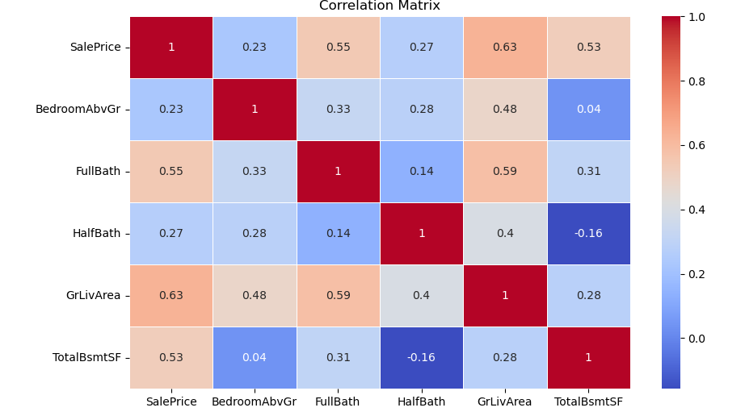

Slide 16
THANK YOU

